Slide 1
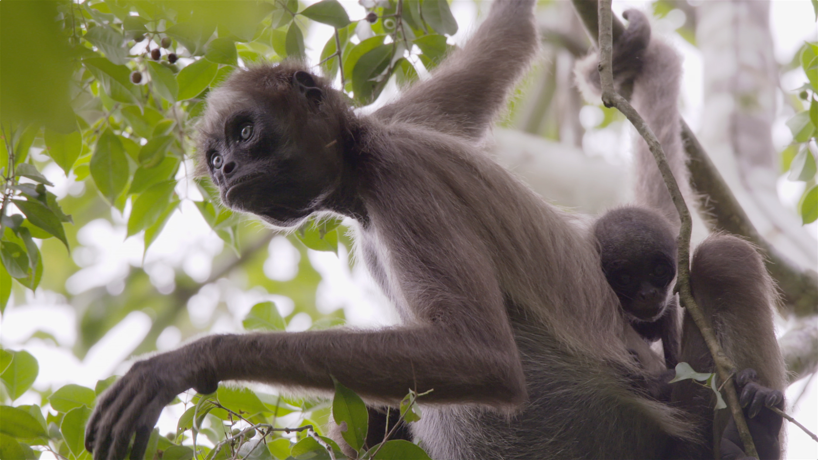
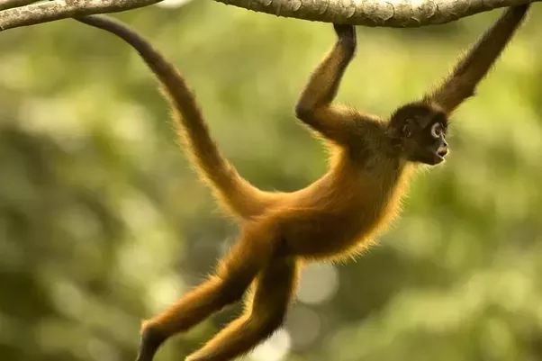
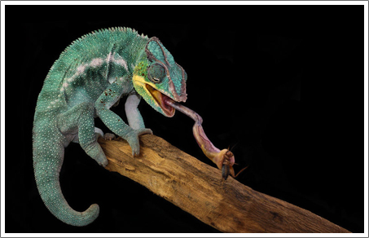
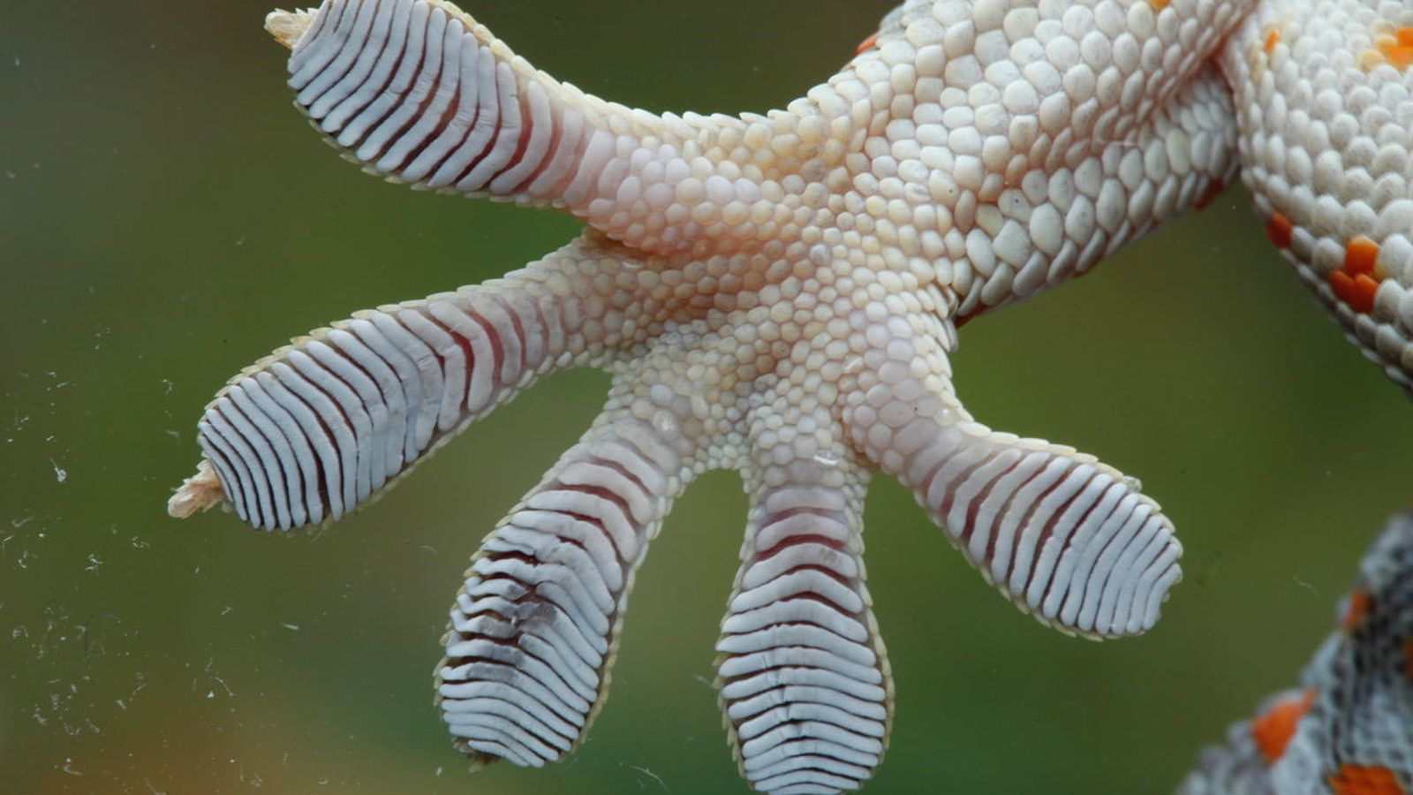
Arboreal Adaptation

Slide 2
Arborial?
Arboreal Locomotion “Tree Climbing” Arboreal locomotion refers to species that live in and move through trees.
These animals often possess physical adaptations that aid in this movement.

Slide 3
These adaptations may include long limbs, prehensile tail, and claws.
Animals that exhibit arboreal locomotion include squirrels, sloths, and monkeys.

Slide 4
Arborial?
Arboreal life is sought for safety, retreat and for abundance and easy pro­curement of food.
From the phylogenetic history of the vertebrates, arboreal life is very significant.

Slide 5
Types
The animals belonging to this cate­gory exhibit different modes of progression:
(a) Branch runners
Progression on the upper surface of the trees by the help of the fore- and hind-­limbs. Most of the arboreal forms move by this method.

Slide 6
Types
b. Forms swinging by the forelimbs
Pro­gression by swinging by the forelimbs is observed only in Primates.
They can move with speed and accuracy by the forelimbs from tree to tree.

Slide 7
Modifications for Arborial Life:
The general contour of the body and the limbs are extremely modified to lead per­fect scansorial life.
Body Architecture:
For climbing, the chest along with ribs, the shoulder and the pelvic region are very strongly built.
In fully arboreal types, the thorax is subcircular and the ribs are extremely curved.

Slide 8
Another modification is the elongation and the increment of the number of the dorsolumbar vertebrae.

Slide 9
Locomotory Organs
Limbs:
In arboreal forms, the proximal portion of the limb becomes extremely elongated and bears a definite ratio with the climbing ability.
The feet may also be modified as prehensile or grasping organs.

Slide 10
The digits in this form may be opposable.
In those cases where the feet are not prehensile, the digits are furnished with powerful claws as seen in Squirrels.
The claws may be curved.

Slide 11
Contd.
Presence of adhesive discs at the tip of the digits or on soles is climbing organs.
These are observed in tree-frogs,.
In tree-frogs the sticky secretion of the adhesive discs helps in adhesion.

Slide 12
Limb Girdles:
The pectoral girdle is strongly built.
The clavicles and scapulae are highly developed.
The clavicles play a very important role and can withstand the pressure of the breast muscles.
The pelvic girdle is less modified.
The ilia become broadened out to support the viscera.

Slide 13
Modification of the Tail:
In most arboreal forms, the tail is pre­hensile. In Chamaeleon the tail is prehen­sile. In non-prehensile forms, the ectoder­mal scales (as in Anomalurus, a flying squirrel) prevent the animal from slipping.
One of the most remarkable examples is Ateles, the spider monkey, where the tail is highly prehensile.

Slide 14
Thank you

